Slide 1
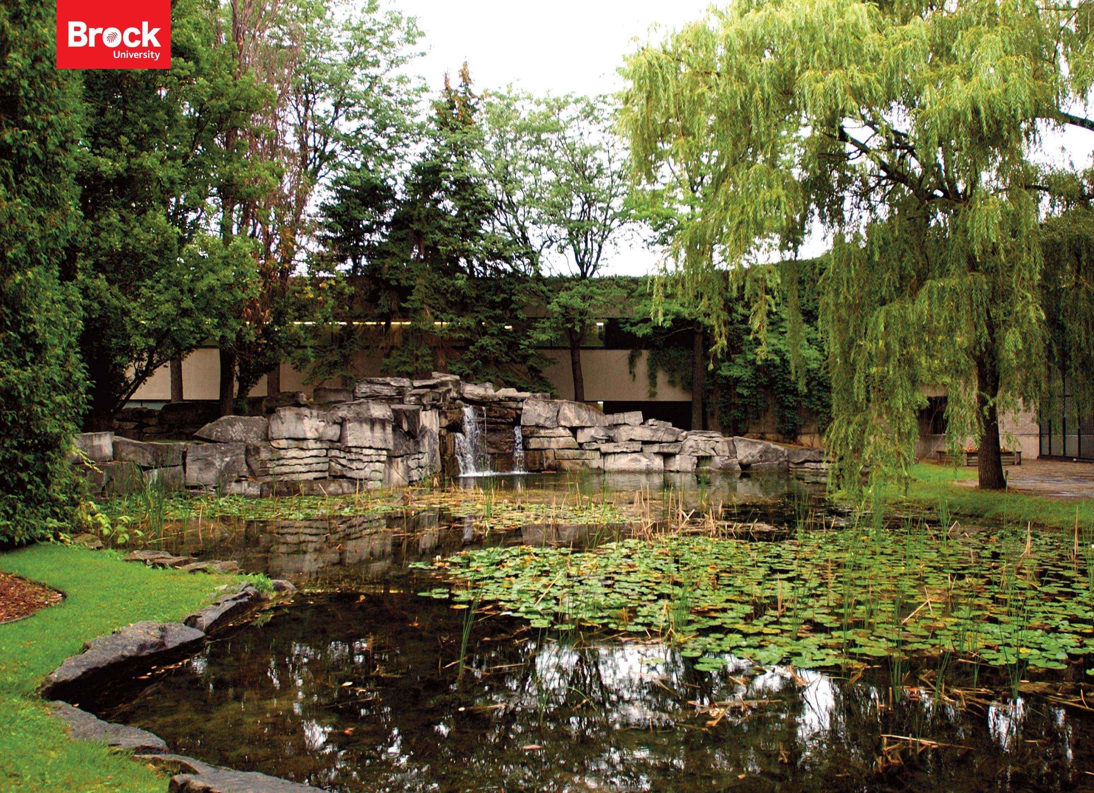
Fall Open House 2017
Faculty of Math & Science
Notes:
1

Slide 2
Faculty of Math & Science
Welcome and thank you for your interest in Brock University
and the
Faculty of Math and Science
Contacts:
Alan Castle
Dean
acastle@brocku.ca
MC D418
Shyamal Bose
Associate Dean
sbose@brocku.ca
MC B207
Heather Bellisario
Academic Advisor
hbellisario@brocku.ca
MC D471
Milica Petkovic
Outreach & Comm. Officer
mpetkovic2@brocku.ca
MC D436
Daniel Lonergan
Co-op, Career & Experiential Education
dlonergan@brocku.ca
MC D412
Dorothy Witte
Executive Asst. to the Dean
dwitte@brocku.ca
MC D407

Slide 3
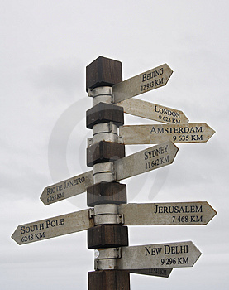
You’ve had a big choice to make and you’re close to deciding where to go next Fall……
Brock
?
University
Is Brock the best University for you?
Notes:
Last Fall you set out to make one of the most important decisions of your life….which Universities should you apply to for this upcoming Fall.
By now you have applied to a few Universities, including Brock [button], which is why you are here today.
We’re here to help you decide [button] if Brock is the best University for you.
3

Slide 4
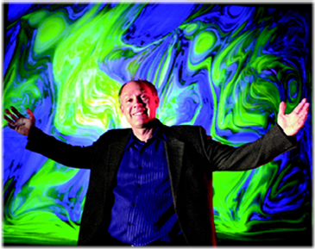
Faculty of Math and Science
We value each and every student, provide them with help and guidance at individual level throughout the span of their study at Brock.
Faculty of Math & Science
Physics Chair Prof.
Bill Ralph
Professor of Mathematics, Pianist and Visual Artist
Mathematics Association of America Teaching Award
We welcome our students with open arms!

Slide 5
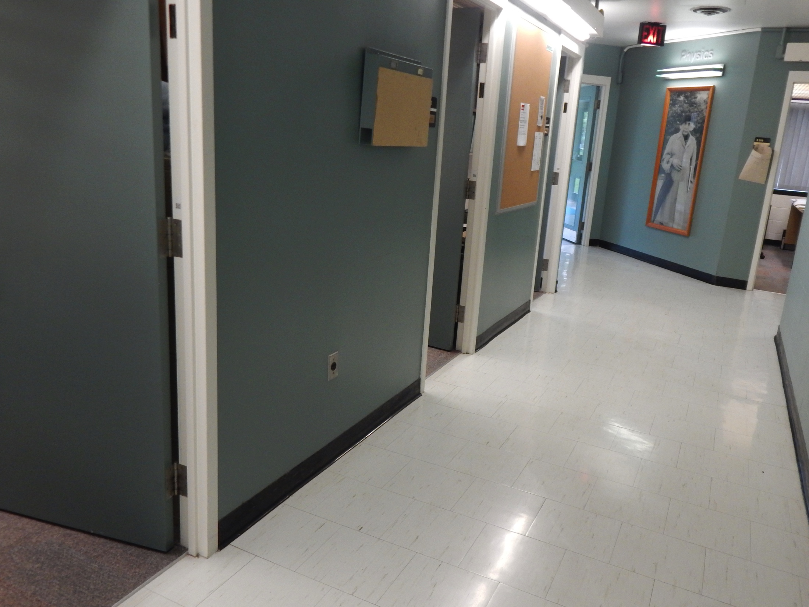
Faculty of Math & Science
Our faculty members follow an open-door policy

Slide 6
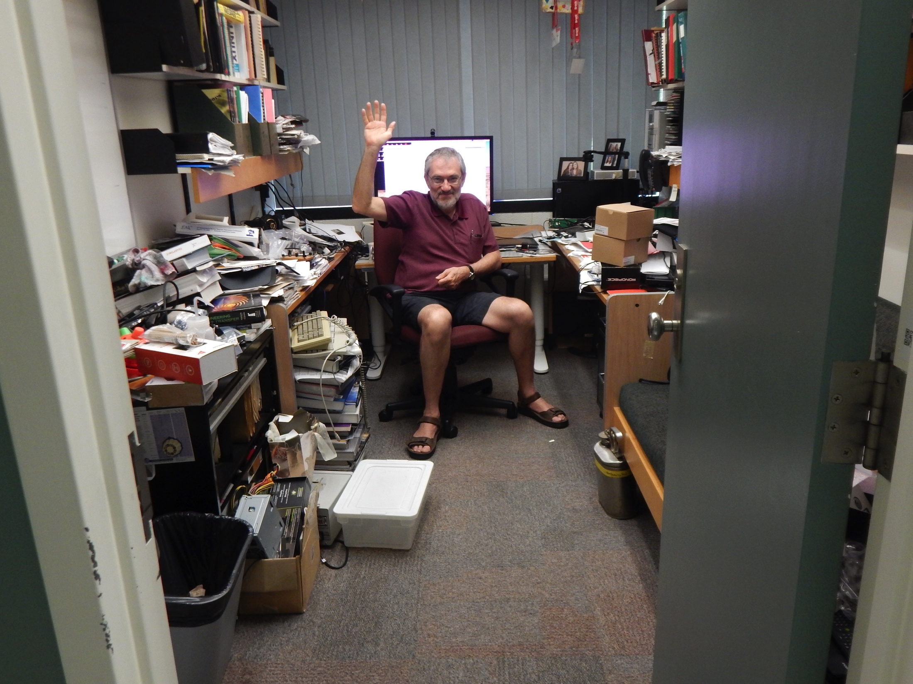
Faculty of Math & Science
Physics Chair Prof. Ed Sternin
FMS Excellence in Teaching Award
They are always (almost always) accessible!

Slide 7
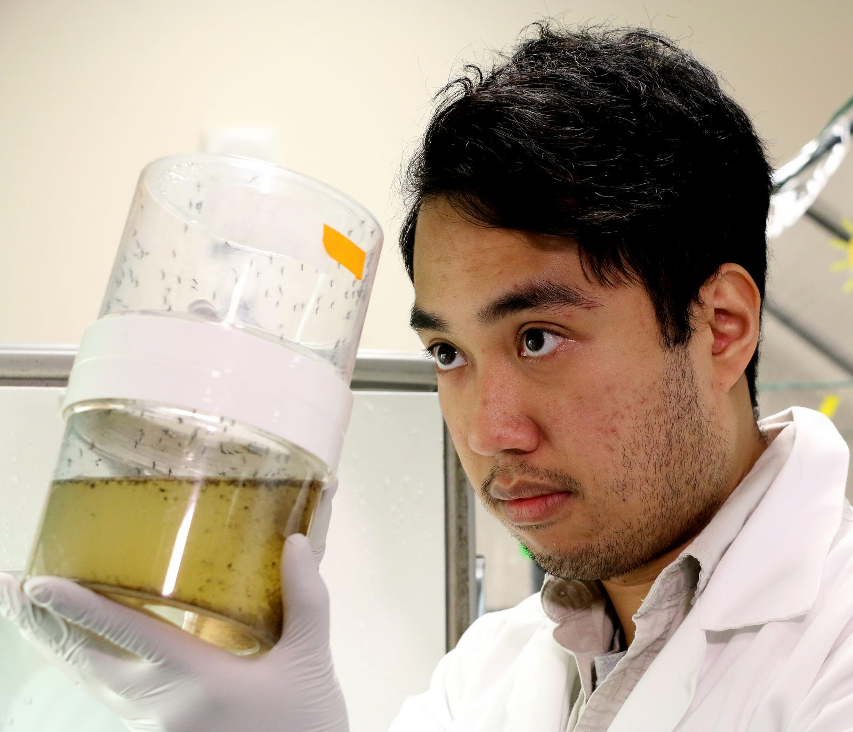
Faculty of Math & Science
Wide range of research opportunities available to undergraduate and graduate students
World Class Research on ZIKA:
Student Darell Agbulos
Member of Prof. Fiona Hunter’s team

Slide 8
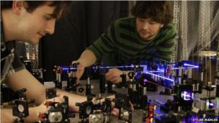
Faculty of Math and Science
Lee Rozema
Faculty of Math & Science
Lee Rozema, BSc'08, is testing the Heisenberg uncertainty principle, and made the cover of BBC Science & Environment News, 2012.09.07
http://www.bbc.com/news/science-environment-19489385

Slide 9
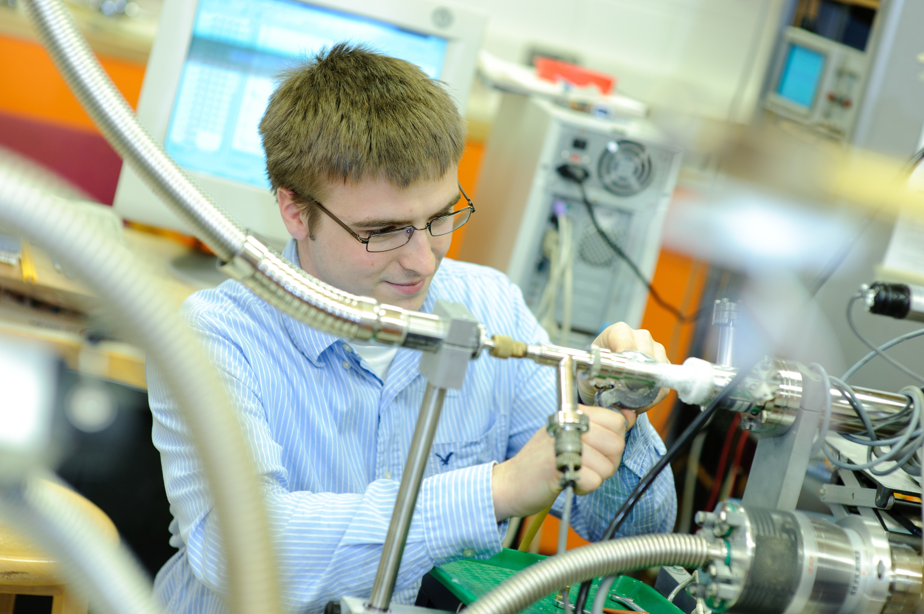
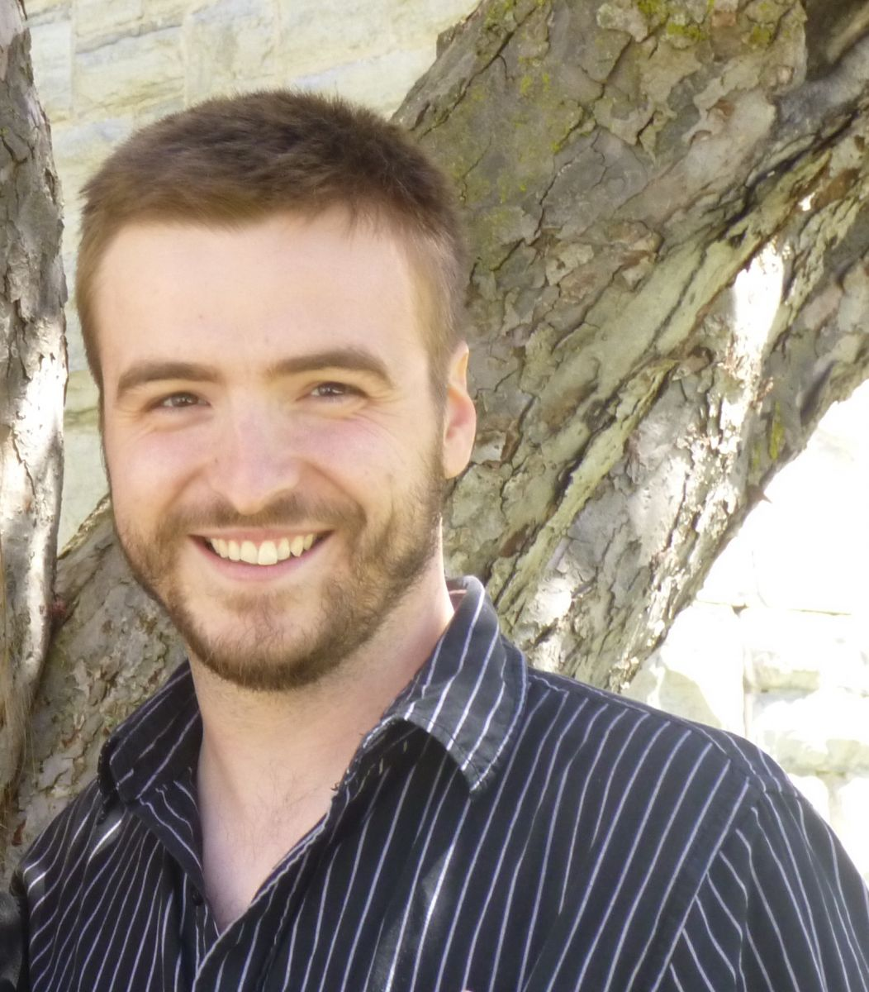
Drew Marquardt, Assistant Professor,
U. of Windsor (2017)
Brock Degrees
BSc Chemistry Hons (2010);
MSc Biophysics (2011);
PhD Biophysics (2014)
Postdoctoral Research:
2 years at University of Graz, Austria
1 year at Oak Ridge National Labs, Tennessee
Awards at Brock:
Vanier Scholarship/NSERC
Ontario Centres of Excellence/NSERC
Weston Foundation Entrepreneurial Award
Experiments took him around the world:
NIST (Gaithersberg, Maryland), ORNL (Oak Ridge, Tennessee), NSLS
(Brookhaven, New York), DESY (Hamburg, Germany) MAX_LAB (Lund, Sweden),
ILL (Grenoble, France), Elettra (Trieste, Italy)

Slide 10
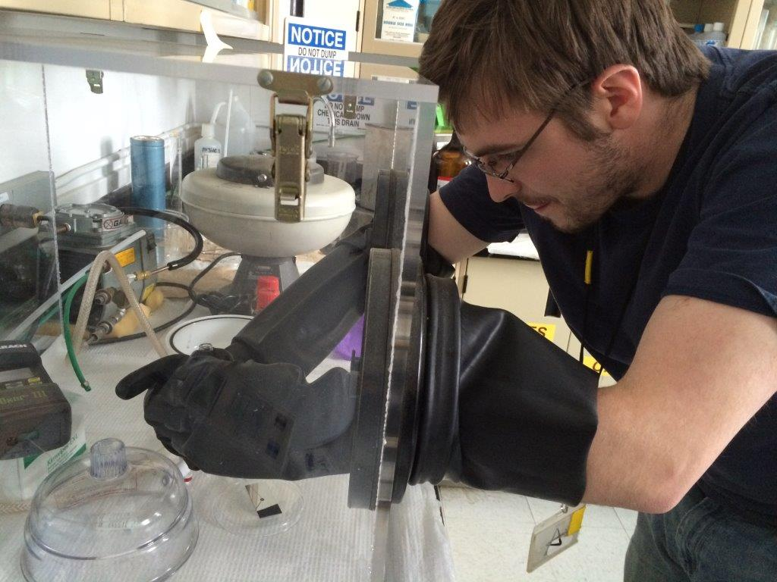
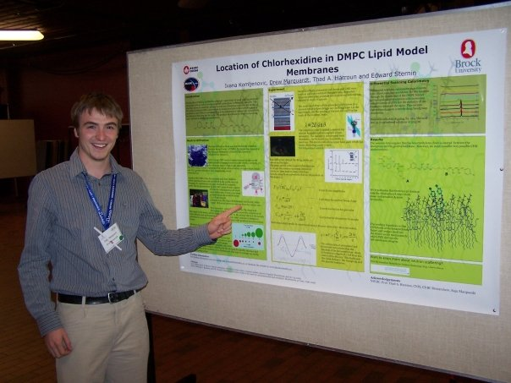
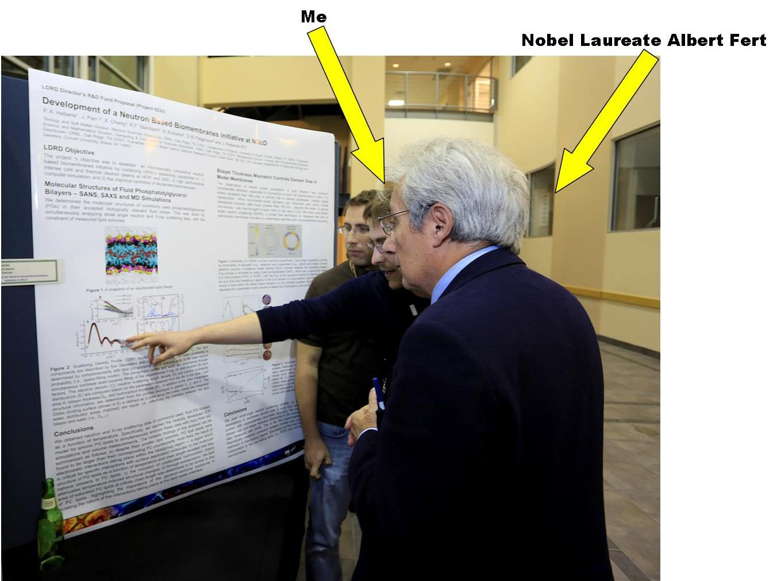
Drew working at Canadian Neutron Beam Centre (Chalk River)
Canadian undergraduate physics conference 2009
Presenting research to Nobel laureate Albert Fert (Nobel Prize for the co-discoverry of giant magnetoresistance) (ORNL, Fall 2013)

Slide 11
Top Value : Undergraduate Research
Faculty of Math & Science
All Honours programs include an undergraduate thesis option in the 4th year of their program
World Class Scientists
CANADA Research Chairs
Members of Editorial Boards of Top Journals
Holders of Patents
http://www.brocku.ca/mathematics-science

Slide 12
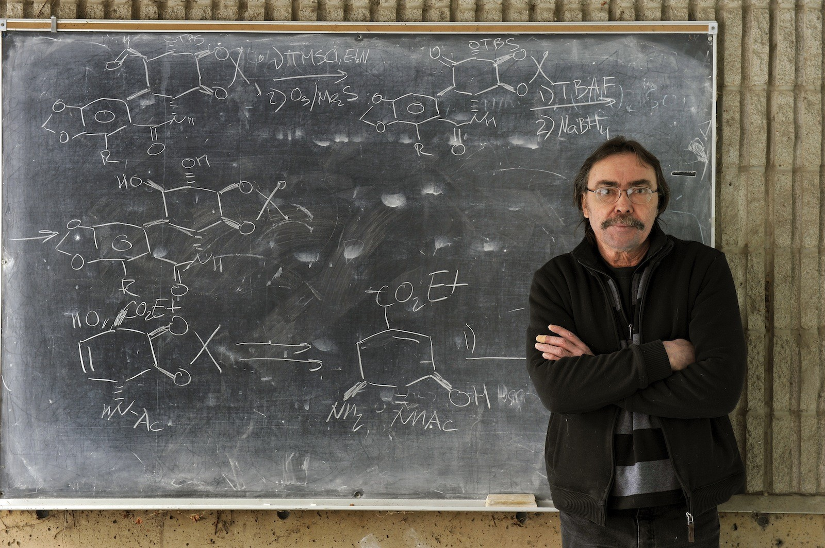
Faculty of Math & Science
Brock scientist’s patented compound is turning out to be a cancer killer
Wednesday, March 22, 2017 | by Cathy Majtenyi
A leading Canadian scientist has developed a synthetic compound that appears to be capable of killing cancer cells while leaving healthy cells intact.
Brock University chemist Tomas Hudlicky has created and patented several variations of the compound pancratistatin, which has been tested on 20 different types of cancer cells by a research team at the University of Windsor. The team’s paper, “Cancer Cell Mitochondria Targeting by Pancratistatin Analogs is Dependent on Functional Complex II and III,” appeared in the February issue of Scientific Reports.

Slide 13
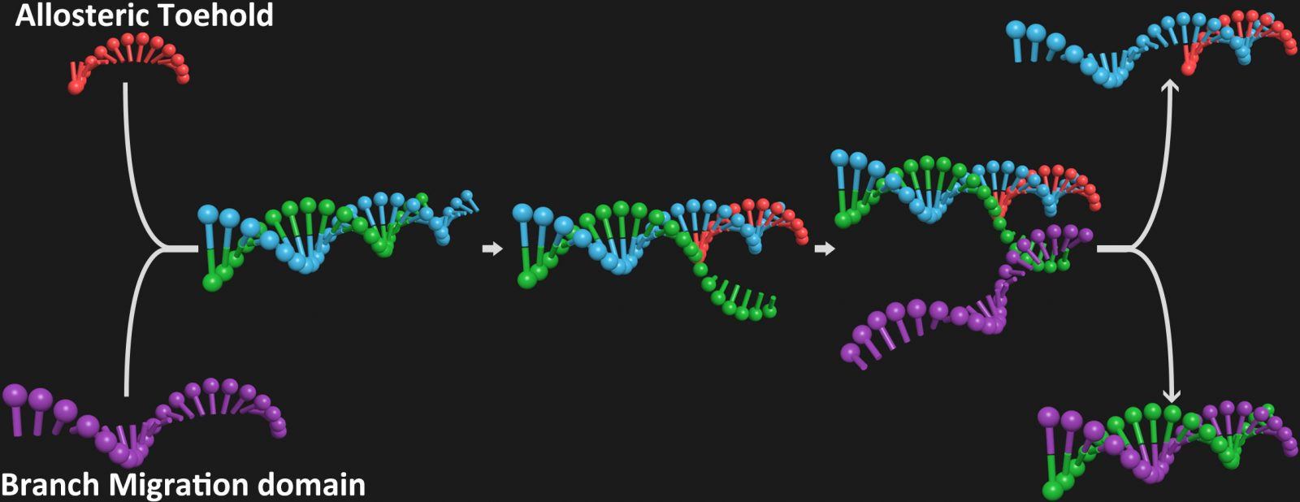
Faculty of Math & Science
Computers with DNA? Brock team working to help make it happen.
A Brock University research team has created a tool that can potentially be used in a future computer that will be made out of DNA.
Chemist Feng Li and graduate student Xiaolong Yang, former postdoctoral fellow Yanan Tang and undergraduate student Sarah Traynor have devised a strategy that “helps simplify the design of DNA circuits that may eventually be used in a DNA computer,” says Li.
The team’s research was recently featured in the Journal of the American Chemical Society.

Slide 14
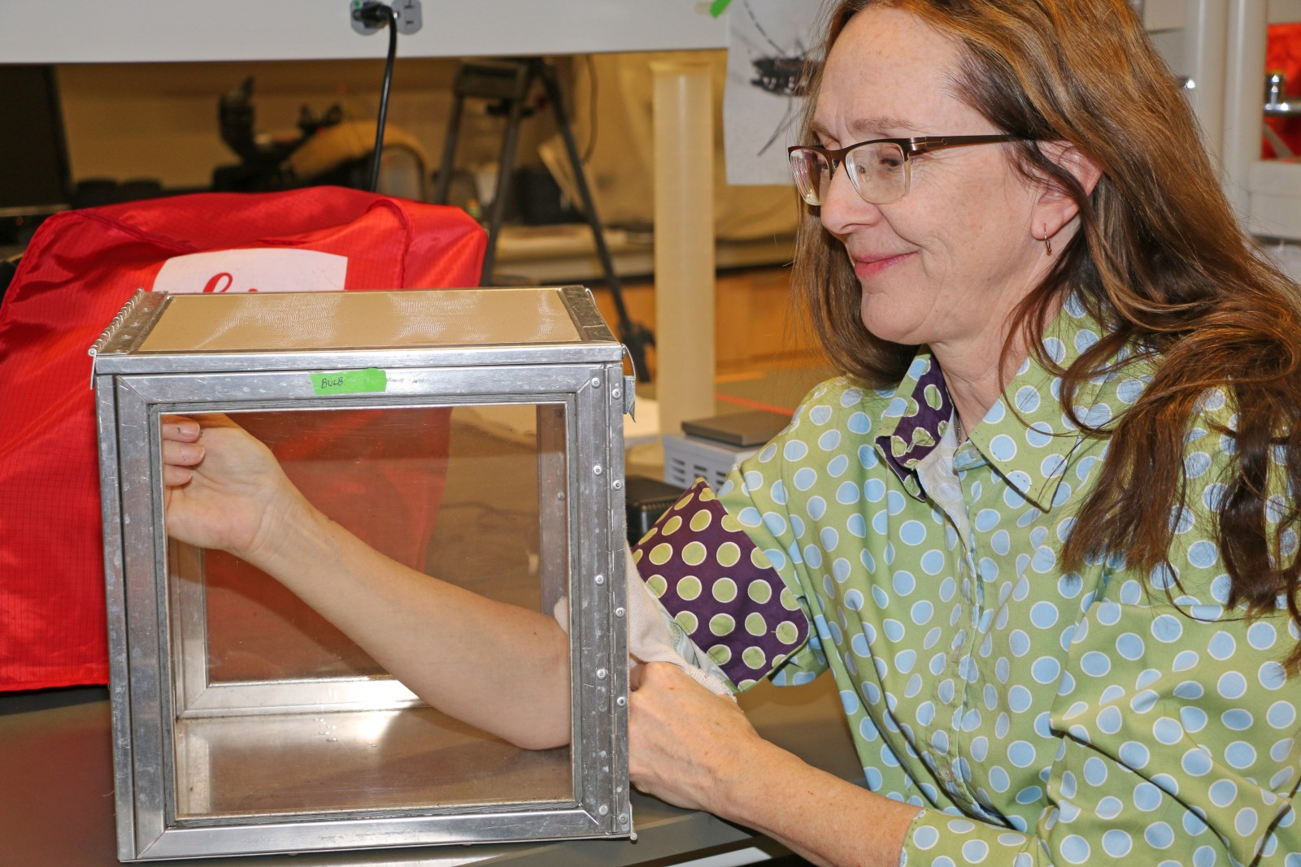
Prof. Fiona Hunter, renowned researcher on West Nile and Zika viruses.
Faculty of Math & Science
Brock University researcher Fiona Hunter allows non-infected mosquitoes to feed on her arm during a demonstration for the media.
Research of Prof. Fiona Hunter and PhD student Bryan Giordano on mosquito-carried viruses featured in CBC’s The National and Global News

Slide 15
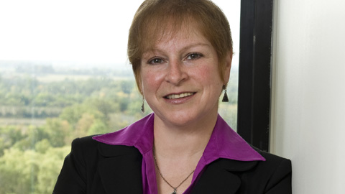
Faculty of Math & Science
The Canadian Commission for
the United Nations Educational,
Scientific and Cultural
Organization (CCUNESCO)
has appointed Brock biologist
Liette Vasseur to head up one
of its commissions.
As President of
CCUNESCO’s Sectoral
Commission on Natural, Social
and Human Sciences, she will be providing knowledge and
expertise on a range of issues.
!
Canadian UN body appoints Brock biologist to senior position
OCTOBER 30, 2017 | by Cathy Majtenyi
Social and environmental impacts of climate change; conservation of
natural heritage and water resources; reconciliation between indigenous and
non-indigenous people; measures to fight discrimination, racism, violence,
bullying and radicalization.

Slide 16
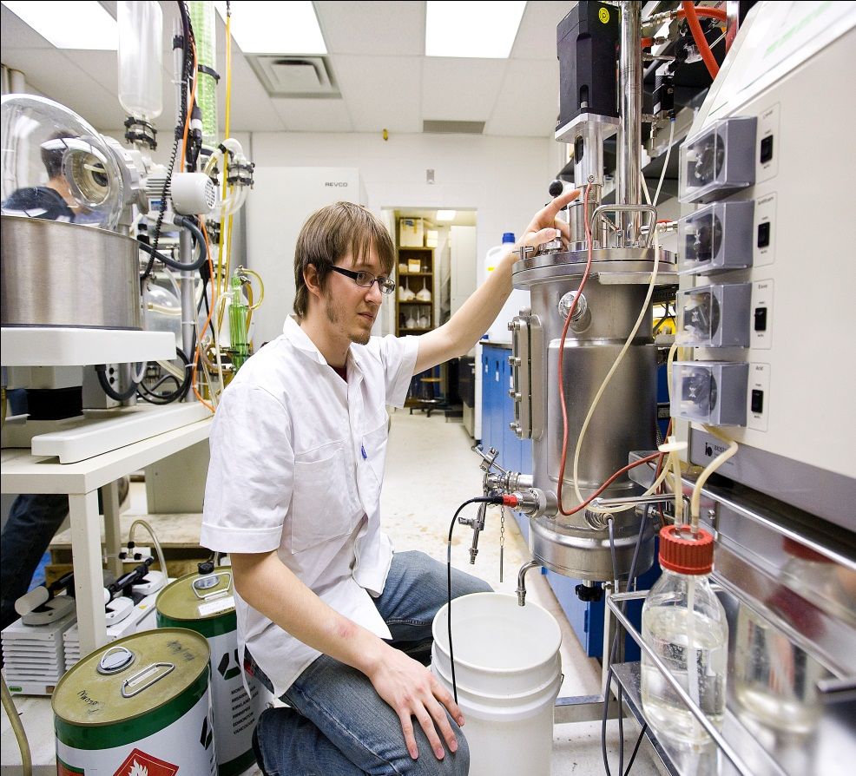
Hands-On Education
Faculty of Math & Science
Not So Known: We Start You with LABS in Year 1! We’re known for our Extraordinary Opportunities for Undergraduate Research
Summer or Part-time Employment in Research Labs for Undergraduate Students
Over 130 Peer Reviewed Publications co-authored by Undergraduate Students
in the last 10 years!

Slide 17
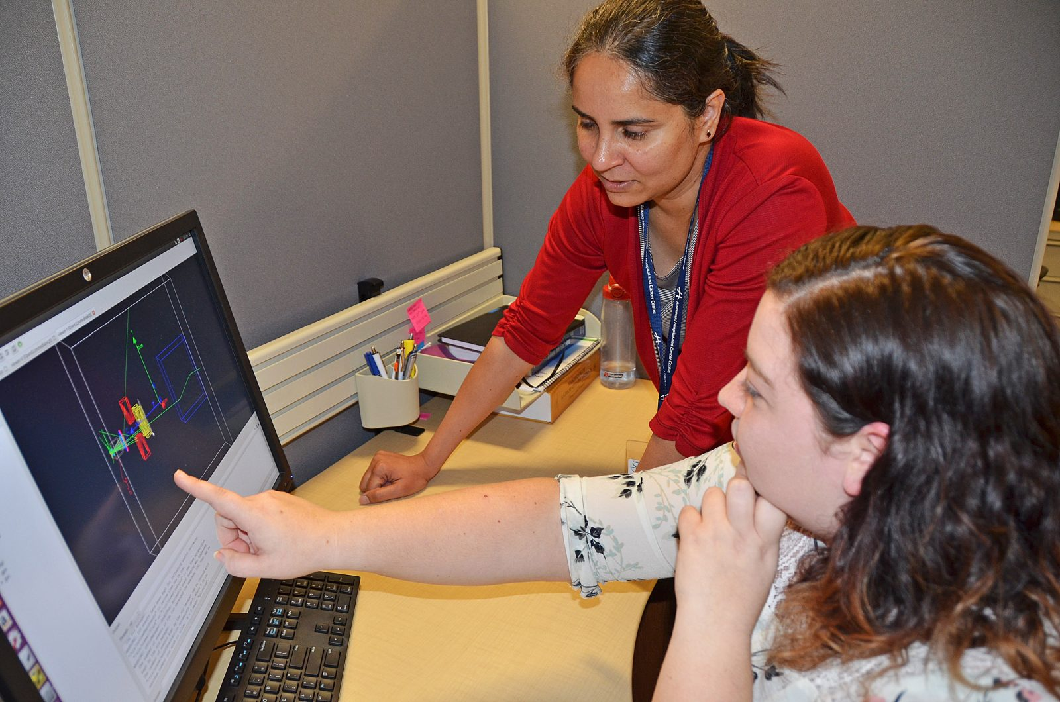
Faculty of Math & Science
Her goal is laser-focused—she wants to help improve cancer treatment.
The fourth-year Brock University
physics student Alicia Martin has been conducting research in partnership with the Niagara Health Systemas part of an experiential learning opportunity, investigating ways to make radiation therapy more efficient.
Alicia Martin with Dr.RanjiniTolakanahalli, Manager of the NHS’s Department of Medical Physics at the Walker Family Cancer Centre
http://yourontarioresearch.ca/

Slide 18
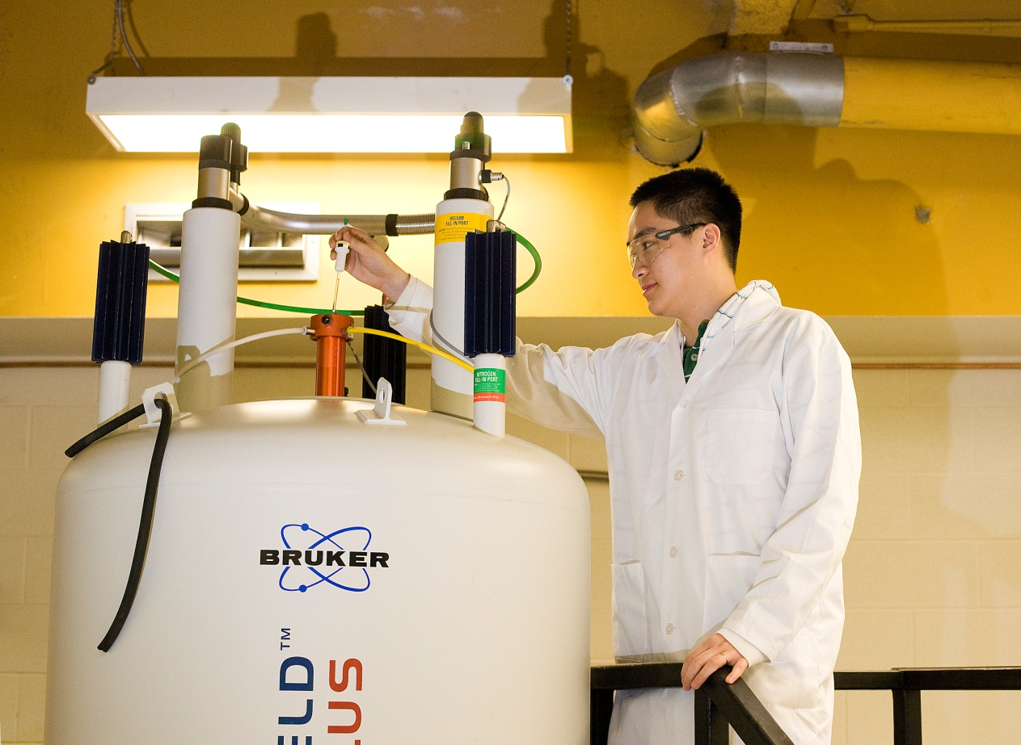
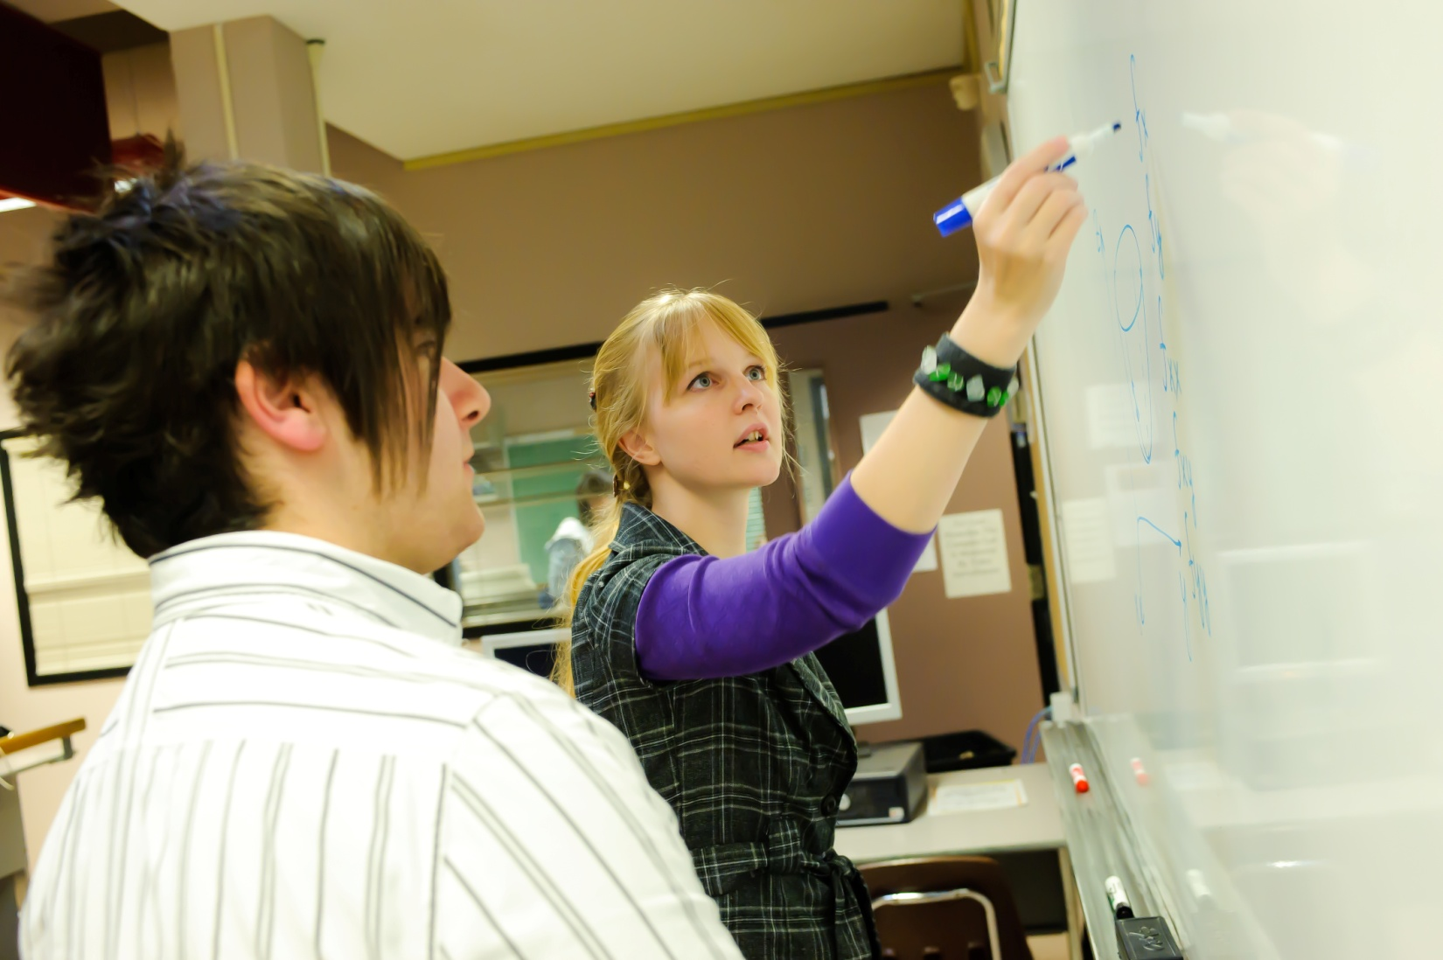
Faculty of Math & Science
Welcoming and Accessible
Environment
+
Top Student/Faculty
Interaction
Experiential Learning
+
COOP Options
Academic Advising
And
Academic Support
Quality of Education
+
Undergraduate Research
Join Brock Science Family:
1800+ Students and 120 Professors & Instructors

Slide 19
Faculty of Math & Science
BROCK RANKING IN THE TOP 4
(Amongst 13 Medium Size Comprehensive Universities)
Most Satisfied Students | Quality of Graduates
Campus Atmosphere | Academic Advising
Academic Counselling | Residences
Research Opportunities (5) | Instructor's teaching style
Quality of Education
Student-Faculty interaction
(+9% Ontario Univ. Average)
http://www.theglobeandmail.com/news/national/education/canadian-university-report/canadian-university-report-2013-student-satisfaction-survey-results/article4631980/
Notes:
19

Slide 20
NSSE 2014 SURVEY RESULTS (Final Year Students Participation: Brock = 45%, Ontario = 34%) | BROCK % | ONTARIO AVG% | ±
Quality of Interaction (% Students responding “Very Satisfied” or “Satisfied”) With Students With Faculty With Academic Advisors Student Services Staff Other Staff | 70 51 45 40 34 | 62 46 37 34 34 | +8 +5 +8 +6 0
Student-Faculty Interaction (% Students responding “Very often” or “often”) Talked About Career Plans with a Faculty Member Discussed Course Topics, Ideas, or Concepts with a Faculty Outside Class Discussed Academic your Academic Performance with Faculty member | 36 33 30 | 28 27 22 | +8 +6 +8
Effective Teaching Practices Taught Course Sessions in an Organized Way Used Examples or Illustrations to Explain Difficult Points Provided Prompt and Detailed Feedback | 79 76 56 | 76 73 51 | +3 +3 +5
Supportive Environment Providing Support to Help Students Succeed Using Learning Support Services | 67 59 | 58 55 | +9 +4
Faculty of Math & Science
Notes:
20

Slide 21
Faculty of Math & Science
NSSE 2014 SURVEY RESULTS | BROCK % | ONT. AVG.% | ±
Overall Satisfaction (% Rating their overall experience as “Excellent” or “Good”) Year 1 Year 4 (Final Year) | 82% 84% | 79% 79% | +3% +5%
Overall Experience (would “definitely” or “probably” attend Brock if they were to start again) Year 1 Year 4 (Final Year) | 87% 81% | 83% 77% | +4% +4%
Notes:
21

Slide 22
Faculty of Math & Science
6 Departments + 2 centres (21 Programs, 16 Co-op Programs)
Biological Sciences
Chemistry
Computer Science
Earth Sciences
Mathematics
Physics
Biotechnology
Neuroscience
~ 1,850 Undergraduate Majors
~ 165 Graduate Students
~ 130 Faculty & Staff (including 90 in Instructional Roles)

Slide 23
Faculty of Math & Science
We’re Known for our Co-op Experience
Ongoing Strong Focus on Experiential Education!
Biotechnology
Biochemistry
Computer Science
Computing and Business
Computing and Network Communications
Computing and Solid-State Device Technology
Earth Sciences
Environmental Geosciences
Mathematics & Statistics
Mathematics and Computer Science
Neuroscience
Oenology and Viticulture
Physics
Co-op Only
Co-op Globe & Mail: 100% CO-OP Placement in Paid Jobs Related to Major
http://www.globecampus.ca/navigator2/brock-university/
Regular and Co-op
Notes:
23

Slide 24
Faculty of Math Science
Brock Co-Op facts:
Co-op admission: Direct entry from high school (check off “co-op” when apply to a specific degree program).
40 Co-op programs in total including both UG (31) and Graduate (9) programs.
15% of full time students at Brock are enrolled in a co-op program.
All UG co-op degree program are HONOUR programs.
Work term location: 45% in GTA, 25% in Niagara, 15% in Burlington/Hamilton, 7% in K/W, 5% in Ottawa area, 3% outside of province or overseas.
Salary range: depending on the size of employers, type of positions, location as well as the level of students, hourly salary rate can be ranged from $11.25 to $35.

Slide 25
Your First Co-op Course will provide you with the basic skills needed to find and successfully hold meaningful employment
SCIE 0N90
Co-op Training and Development
Framework for the development of learning objectives for individual work terms, for students in the co-op programs in the Faculty of Mathematics and Science. Includes orientation to the co-op experience, goal setting, career planning, résumé preparation and interview skills preparation.
Lectures, presentations, site visits
Faculty of Math & Science

Slide 26
Faculty of Math & Science
Some past employers
Amazon, Spring/Summer Software Development Engineer, Toronto
Arrow Electronics, Project Coordinator Internship, Mississauga
ArcelorMittal Dofasco, Process Automation Department, Hamilton
BAI Canada Inc., Software Development, Toronto
Canadian Space Agency, St. Hubert, Quebec
Ciena Corp., Software Engineering, Optical Transport Systems, Ottawa
Cisco Systems, Sales Development Intern, Toronto, Ottawa, Halifax
Claude Resources Inc, Jr. Environmental Coordinator, Seabee Min, SK
Smithsonian, Analytical Studies Group Intern, Suitland, Maryland, USA
Spartan Bioscience Inc., Research Assistant, Ottawa
STEM Camp, Science, Tech., Eng. Math. Camp Counsellor- Ontario Wide
Toronto Hydro, Co-op student IT Services & Applications, Toronto
Toronto Hydro, GIS Analyst, Toronto
TRIUMF, Vancouver, B.C.
Vineland Research and Innovation Centre, Agriculture Canada,
Vineland

Slide 27
Why choose sciences at Brock?
Faculty of Math & Science
Not sure about what Science Program to Join?
Consider the Bachelor of Science
Flexible and Personalized Study-Plan
No Major to Declare (after year 1 choose areas of concentration)
Ideal Transition High-School University
Appealing to Those Who Want to Design Their Program

Slide 28
Faculty of Math & Science
Brock Scholars Award
$4,000 $6,000
$1,000 each year $1,500 each year
80-84.9% 85-89.9%
$10,000 $16,000
$2,500 each year $4,000 each year
90-92.9% 93+%
Brock Leaders Citizenship Award
$8,000 ($2,000/yr)
More than $4 MILLION awarded to entering students each year
Notes:
28

Slide 29
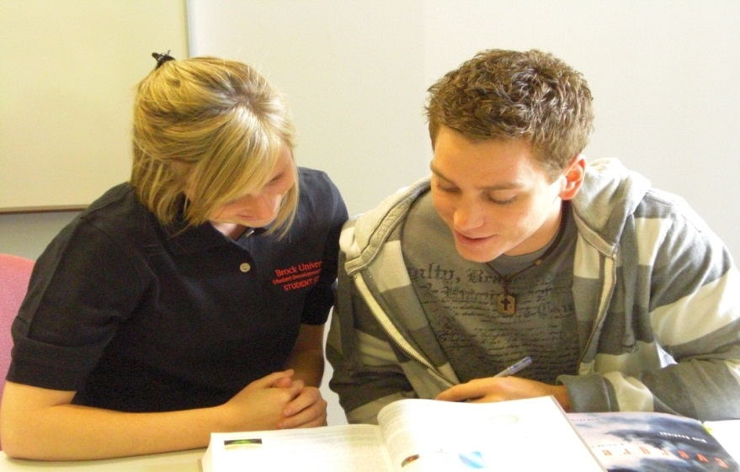
Advising and Academic Support
Faculty of Math & Science
At Brock you are never alone! There are many Support Services in place to ensure your success
Drop-In Help
All Year Long Advising
Math Learning Center
Special Workshops
Drop-In Assistance
Free to all students
1-on-1 or small groups
In your Department
Faculty of Math and Science Academic Advising
Student Development Center

Slide 30
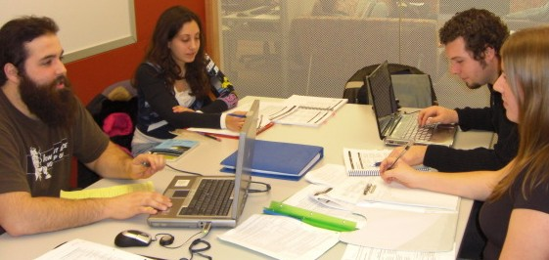
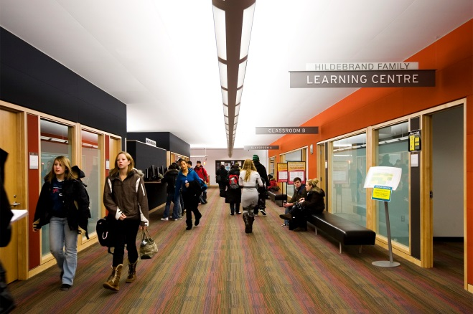
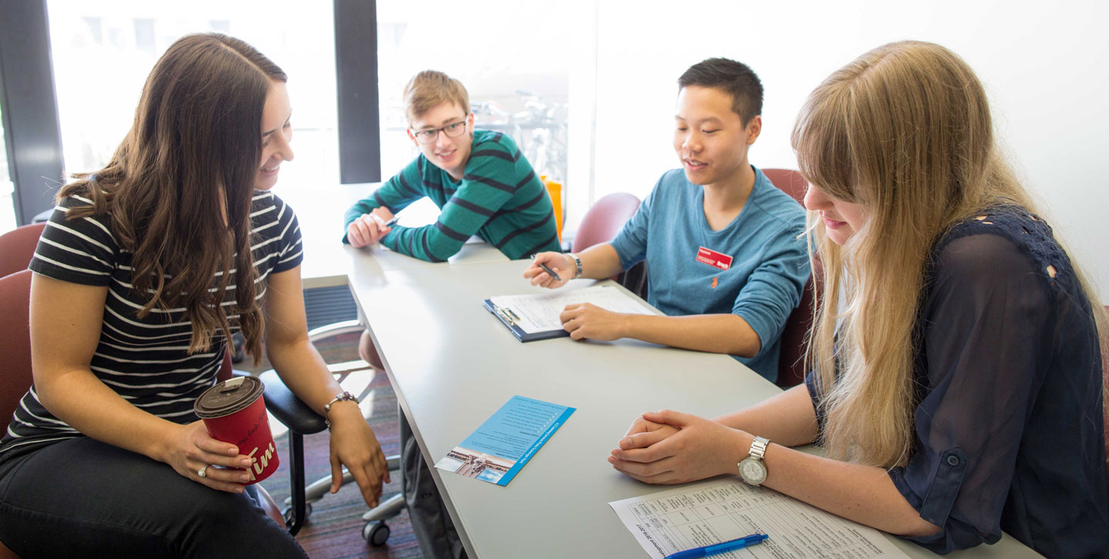
A-Z Learning Services
Faculty of Math & Science
A-Z Learning
Services @ Brock
Workshops
Consultations
For details go to: www.brocku.ca/learning-services
Drop-In Learning Service
Tutor Registry
Notes:
Workshops are pre-schedule and can be requested (by professors or a group of students—minimum 4 students)
Workshop examples:
Solving Equations
Problem Solving in Chemistry
How to Succeed in Science
Exam Preparation
Time Management
Critical Thinking
Creating a Math Cheat Sheet
Get the Most Out of Lectures
2. Tutor Registry (request a tutor or be a tutor). Students pay for this service (if you’re an Aboriginal student, a First Generation student, or a Ontario College or University transfer student, you can be eligible for some free tutoring hours)
3. Professors can request academic-zone.com access for their classes, or students can request registration in the Drop-In centre.

Slide 31
Faculty of Math & Science
~ 19,000 students : small enough to be intimate, big enough to be world class
98% Graduate success: Brock has one of the highest rates of graduate employment
Students from more than 94 countries, more than 80 partner institutions on 6 continents
Our annual Brock Grape stomp has been recognized as a great Canadian Campus Tradition

Slide 32
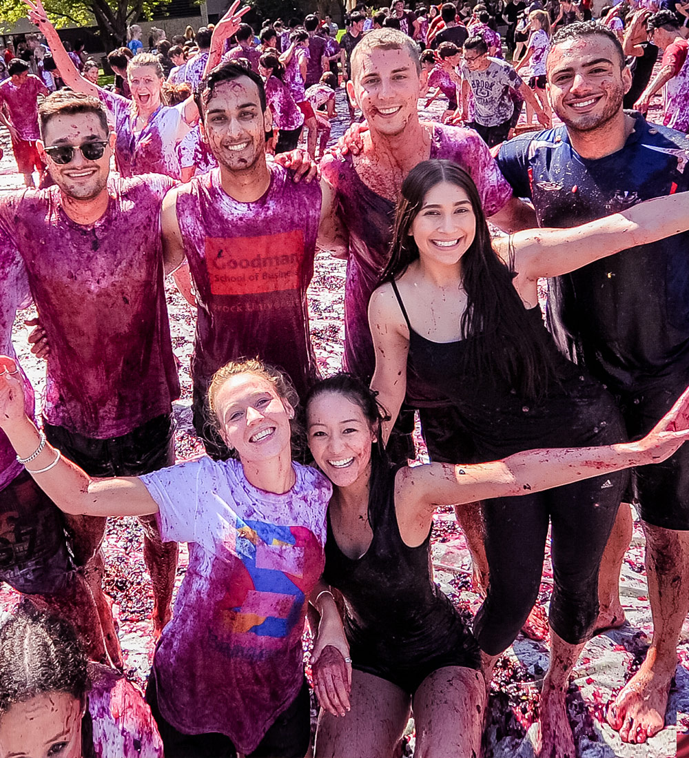
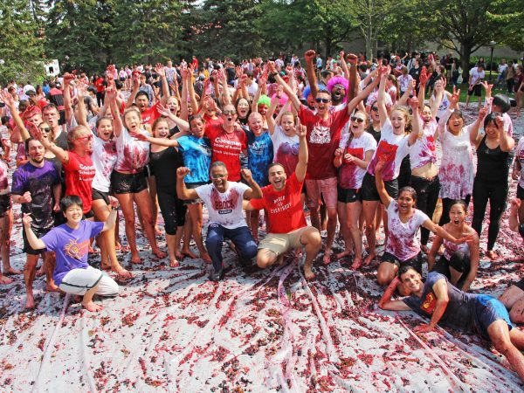
Faculty of Math & Science
Annual Home Coming
Grape Stomp Event-
Canada’s Messiest University
tradition
Gallery

Slide 33
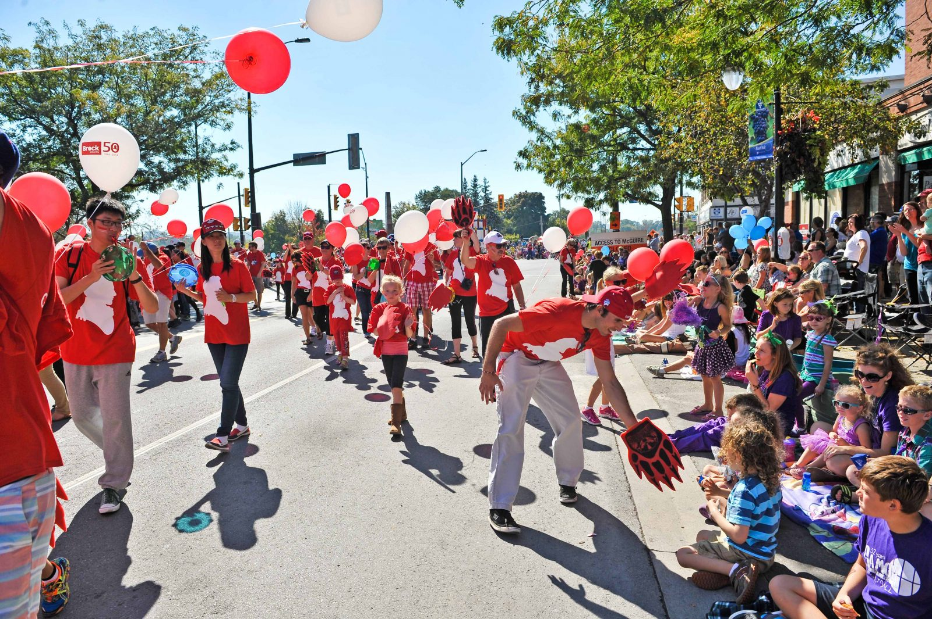
✕
Faculty of Math & Science
Brock steps up to promote a safe, respectful Grape and Wine weekend
FRIDAY, SEPTEMBER 22, 2017 | by Kevin Cavanagh

Slide 34
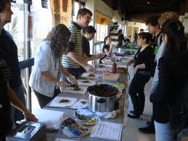
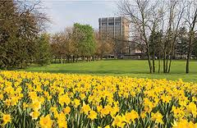
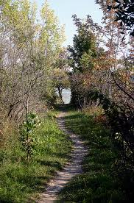
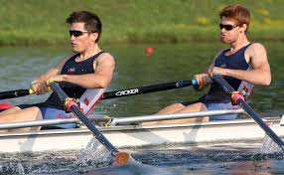
Campus Life and Pleasant Environment
Faculty of Math & Science
Safe and Inspiring Campus; Sense of Belonging; Awards and Scholarships; Athletics; Proximity to Home; Our Commitment to Your Success!
This is how our former students remember us

Slide 35
Brock University is
among five Canadian
host sites selected for
new Rowing Canada
hubs aimed at identifying and training up-and-coming national-calibre rowers.
Rowing Canada announced Thursday, Oct. 26 that Brock University, the University of British Columbia, University of Victoria, Western University and Trent University have been selected to host the Rowing Canada NextGen Hubs.

Slide 36
Thank you for Coming!
Talk to Us For More Info!
… Make sure to complete the right 4U courses!
It’s your future …........…
…we’ll help you get there

Slide 37
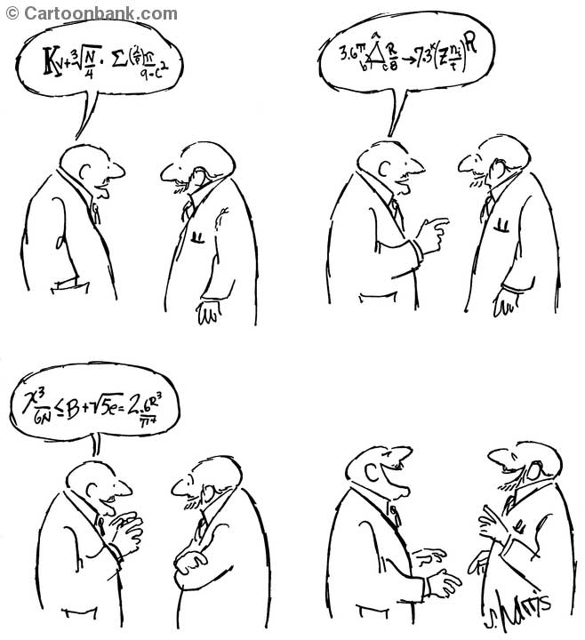
Faculty of Math & Science
Become a scientist. You will develop a unique sense of humour, and be able to share jokes with your colleagues that nobody else will be able to understand !

Slide 40
We Offer Small Class Sizes
Faculty of Math & Science
Small Class Size = Quality
Subject | First Year | Fourth Year
BIOL | 495* | 2 - 43
COSC | 22 – 268* | 7 - 24
CHEM | 350* | 2 - 26
ERSC | 180* | 1 - 21
MATH | 50 - 90 | 4 - 34
PHYS | 70 | 4 - 12
* Service courses with majority of non-majors

Slide 41
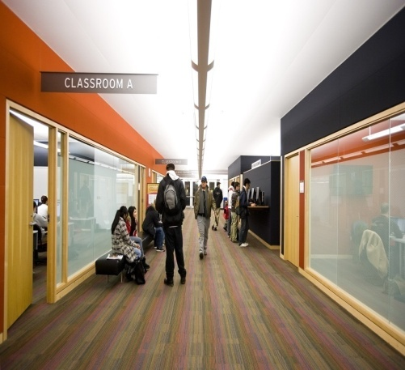
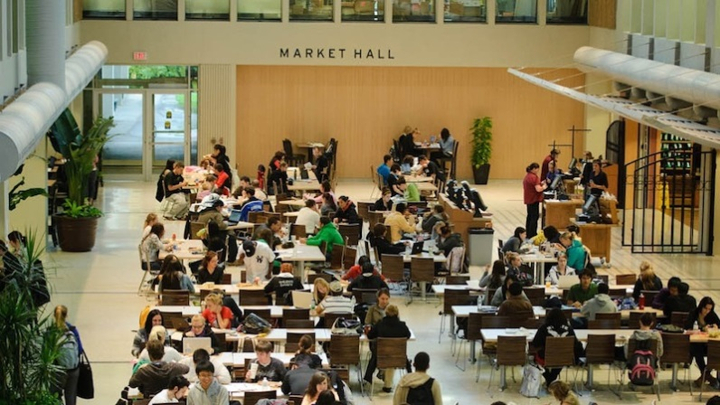
Finding A-Z Learning Services
F
A-Z Learning
Services @ Brock
Faculty of Math & Science
STUDENT DEVELOPMENT CENTRE I BROCK UNIVERSITY
Thistle 131
(beside Guernsey Market)
Matheson Learning Commons
(main floor of the library)
Drop-in
& Workshops
Offices
www.brocku.ca/learning-services

Slide 42
Faculty of Math & Science
Finding A-Z Learning Services
Matheson Learning Commons
(main floor of the library)
Thistle 131
(beside Guernsey Market)
Offices
Drop-in
& Workshops
Student Development Centre
Brock University
www.brocku.ca/learning-services
42
A-Z Learning Services © 2014
Notes:
42

Slide 43
Faculty of Math & Science
We Offer Small Class Sizes
Small Class Size = Quality
 | First Year | FoFurth Year
BIOL | ~500* | 2 - 45
COSC | 25 – 275* | 10 - 25
CHEM | 100-350* | 5 - 25
ERSC | ~185* | 5- 20
MATH | 50 – 300* | 5 - 35
PHYS | 100-200* | 5 - 15
Subject
First Year
Fourth Year
* Service courses with majority of non-majors
Notes:
43

Slide 44
Faculty of Math & Science
A-Z Learning Services
Workshops
Drop-In Learning Service
Consultations
Tutor Registry
For details go to: www.brocku.ca/learning-services
44
© 2014
Notes:
Workshops are pre-schedule and can be requested (by professors or a group of students—minimum 4 students)
Workshop examples:
Solving Equations
Problem Solving in Chemistry
How to Succeed in Science
Exam Preparation
Time Management
Critical Thinking
Creating a Math Cheat Sheet
Get the Most Out of Lectures
2. Tutor Registry (request a tutor or be a tutor). Students pay for this service (if you’re an Aboriginal student, a First Generation student, or a Ontario College or University transfer student, you can be eligible for some free tutoring hours)
3. Professors can request academic-zone.com access for their classes, or students can request registration in the Drop-In centre.
44

Slide 45
MATHEMATICS LEARNING CENTRE
A resource for students in first-year mathematics and statistics courses
What can you expect from the MLC?
The MLC provides free, drop-in help for students registered in first-year mathematics courses.
Questions regarding course concepts or material can be discussed with course-specific Teaching Assistants, who are available at select times each week.
Workshops or special help sessions are also offered by the MLC throughout each semester. The MLC also helps develop online course modules for first-year calculus courses.
Students registered in any mathematics course are encouraged to use the MLC as space for independent or group study.

Slide 46
Drop-In Learning Centre
Faculty of Education
Drop-In Learning Centre
DEDICATED TO MATHEMATICS & SCIENCE
MONDAY TO THURSDAY 9-7PM & FRIDAY 9-4PM
Starting Monday, September 11
Location – ST 231

Slide 47
Faculty of Math & Science
Some of the strengths of Brock Faculty and Staff:
Dedication to teaching and learning
Research and innovation
Scholarly and creative activities
Student engagement and campus experience
Brock's new President, Dr. Gervan Fearon
in a recent interview to Brock Press
(August 2, 2017)

Slide 48
Faculty of Math & Science
Med Plus
Interested in pursuing a career in health care?
Med Plus is a four-year non-credit program which runs concurrently with students’ academic study.
Job shadowing: Med Plus students can experience “a day in the life” of a health care professional.
Volunteer opportunities (50 hr/yr)
Skill development workshops
Speaker series/observational visits
Mentorship

Slide 49
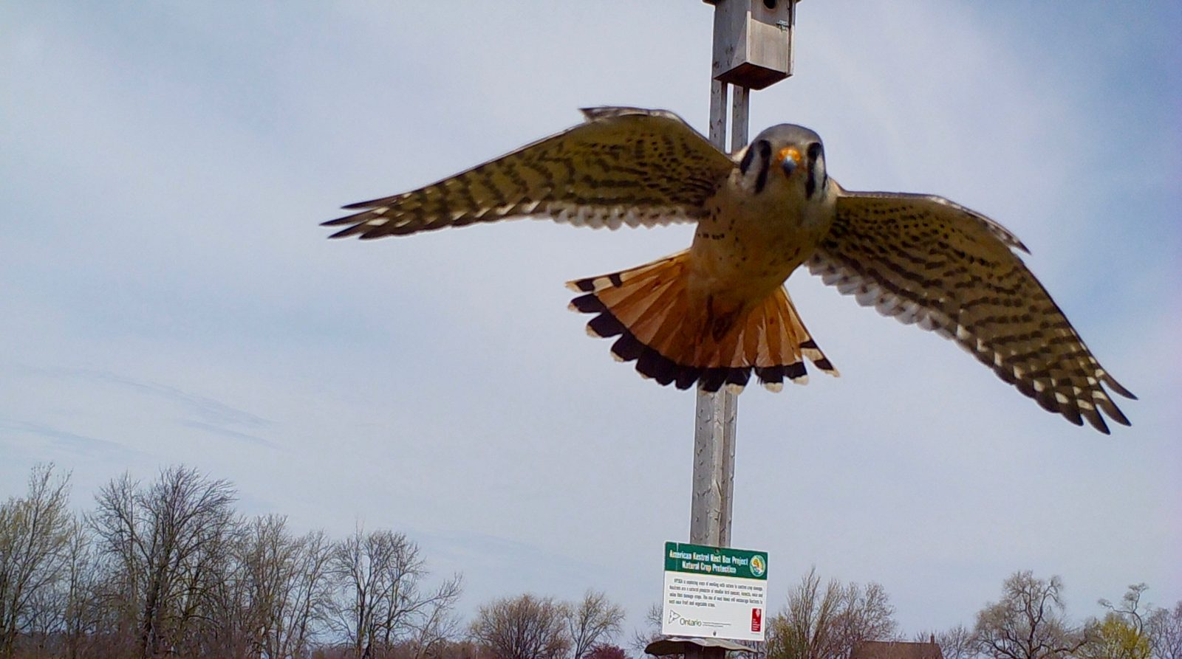
Faculty of Math & Science
Kestrels as crop cops? It’s an award-winning idea
Thursday, November 17, 2016 | by Kaitlyn Little
A project involving Brock University researchers — in which kestrels protect orchards and vineyards from fruit-eating birds — has won a prestigious award from the Ontario government.
Each year Ontario growers lose more than $24-million worth of fruit to wild birds. Seeking ways to protect crops, the Ontario Fruit and Vegetable Growers’ Association (OFVGA) partnered with Brock researchers to install nesting boxes for the American kestrel near orchards and corn fields.

Slide 50
Faculty of Mathematics and Science
Faculty of Math & Science
Experiential Education in Math & Science
CURRICULAR
Co-op
Conference Participation
Creative, Entrepreneurship or Design Project
Events
Research Project
Internship
Field Experience
(local/national/international, short/long-term)
Lab
Projects
Simulation and Experimentation
Service Learning
CO-CURRICULAR
Campus-wide Co-curriculum
Formal, organized Brock activities
Entrepreneurship & Innovation
Publication or Conference Presentation
“Plus” Programs
Study Aboard or Exchange
Teaching and/or Research Assistantship
VITAE

Slide 51
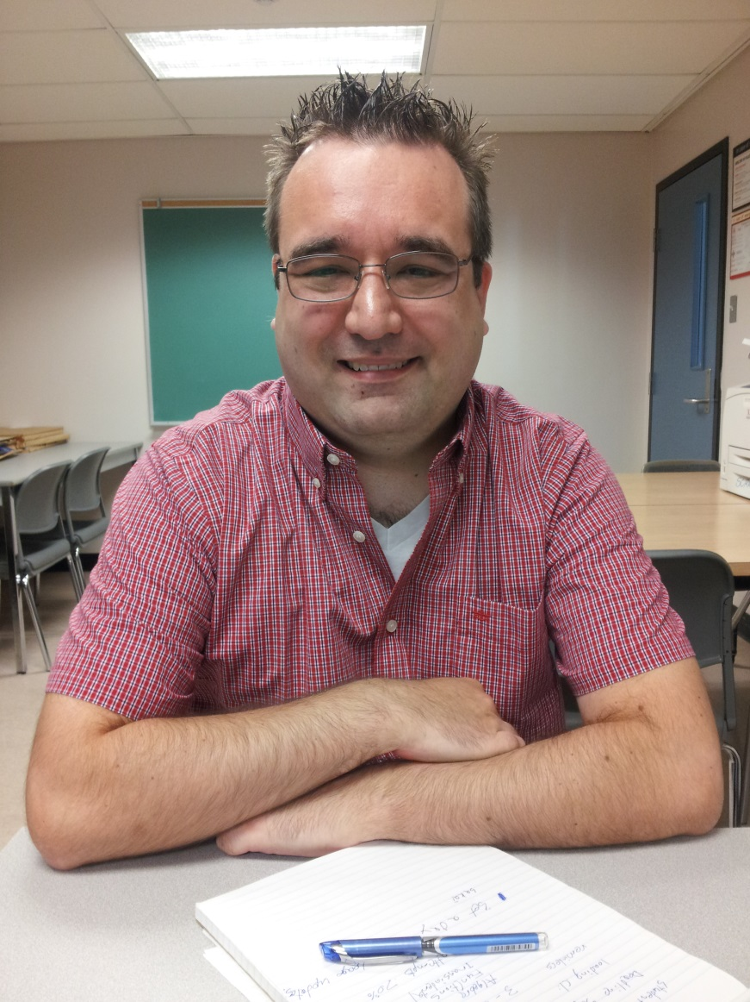
Come visit us in the
Mackenzie-Chown Complex
Block J
Room 434
Contact: Neil Marshall
Room MC J429
Ext. 3138
Visit:
www.brocku.ca/mathematics
And follow the links to the MLC!
Notes:
51

Slide 52
Faculty of Math & Science
A DESTINATION OF CHOICE
World Class Research on ZIKA:
Student Darell Agbulos
Member of Prof. Fiona Hunter’s team
Dr. Shyamal Bose
Associate Dean
sbose@brocku.ca
Heather Bellisario
Academic Advisor
hbellisario@brocku.ca
http://www.brocku.ca/mathematics-science
Notes:
52

