Slide 1
Kapitza-Dirac Effect
Eric Weaver
Phys 4P62

Slide 2
General Outline
Theorized in 1933 by Kapitza and Dirac
Reflection of electrons from standing light waves
Example of atom optics and particle-wave duality
  Matter is affected by potentials of light
  Electron behaves as wave and light as a particle

Slide 3
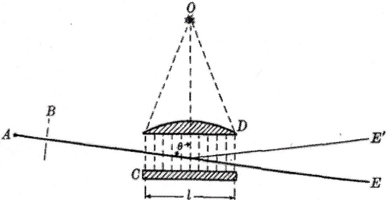
Kapitza & Dirac’s Theory
Accelerate electron beam between A & B
Collimate Electron Beam by passing through diaphragm B.
Observation Criteria
Light lattice spacing =
Bragg’s Law

Slide 4
Kapitza & Dirac’s Theory
Counter propagating waves
Each wave would result in Compton scattering
Compton scattering is proportional to intensity of electron source
Interest in stimulated Compton scattering
Proportional to the product of intensities
High intensity light source required

Slide 5
Kapitza & Dirac’s Theory
The ratio of reflected electron to total electrons where:
  is the intensity of the light source
  is the intensity of the stimulating beam per unit frequency range
  is the frequency of the light source
  is the interaction time
  U is the accelerating potential
  is the group of constants

Slide 6
Kapitza & Dirac’s Theory
Thomson’s cross section was used to determine the intensity scattered in the backward direction.
is the intensity per unit solid angle of the backwards reflected photon by one electron
For the stimulated emission the right hand side is multiplied by Einstein's coefficient for the case of non-polarized light.
is the intensity of the stimulating radiation per unit solid angle per unit frequency range
Apply this relation over a small angle , multiply by the interaction time, and divide by the energy of one quantum.
Resolve the light source into its harmonics
  i.e

Slide 7
Kapitza & Dirac’s Conclusions
Experiment could not be conducted with the available equipment
Reflection on the order of
High intensity source with low spectral broadening is required
The experimental evidence would have to wait until the invention of lasers.

Slide 8
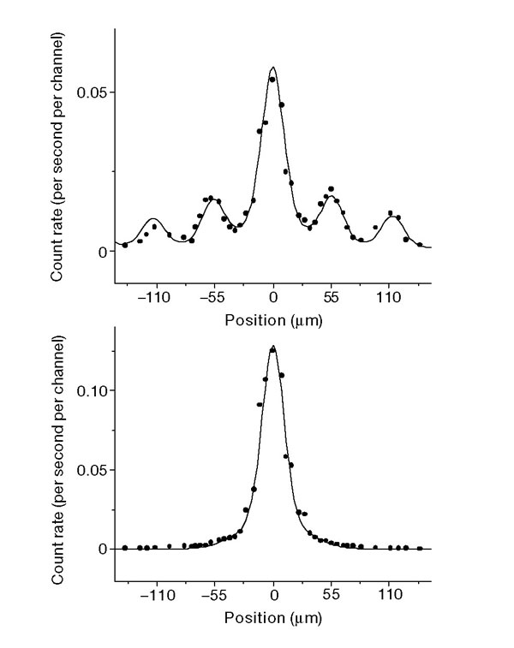
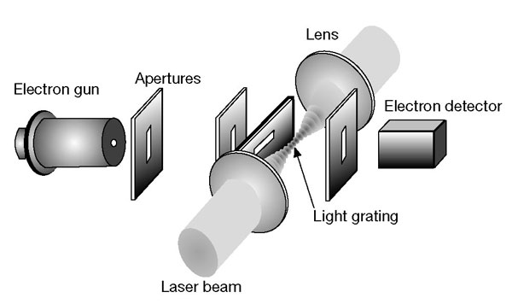
Experimental Observation
Batelaan group experimental set-up
0.2 J/pulse
10 ns pulse
125 μm beam waist
380 eV electron beam

Slide 9
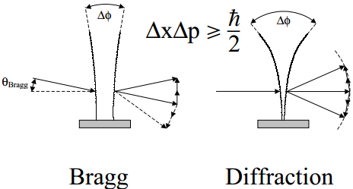
Interactive Regime
The uncertainty is position of photon absorption limits the number of diffraction orders
Curvature of wave fronts and higher orders.

Slide 10
Interactive Regime
Energy – Time uncertainty
Interaction time with uncertainty
results in only one diffractive order
results in many diffractive orders

Slide 11
Interactive Regime
Interaction time and light potential correspond to two experimental parameters
Results in four regimes
  Non-interacting
  Channelling
  Bragg
  Diffractive

Slide 12
Motivation
Coherent beam splitter for matter waves
  Essential component for interferometers.
  Increased sensitivity

Slide 13
References
P. L. Kapitza and P. A. M. Dirac (1933). The reflection of electrons from standing light waves. Mathematical Proceedings of the Cambridge Philosophical Society, 29, pp 297-300 doi:10.1017/S0305004100011105
Schwarz, H. The reflection of electrons from standing light waves, Zeitschrift für Physik 204, 276-289 (1967).
arXiv:quant-ph/0007094
Freimund, D., Aflatooni, K. and Batelaan, H., Observation of the Kapitza-Dirac effect, Nature 413, 142-143 (2001).

